Slide 1
Customer Data Analysis using Excel and Power BI

Slide 2
Project Overview
Analyze customer shopping behavior using Power BI
Understand patterns in gender, age, category, and payment methods
Identify primary revenue drivers
Provide data-driven recommendations to improve sales.

Slide 3
Project Objectives
Analyze customer behavior by gender and age
Identify high-revenue customer segments
Study product category performance
Analyze payment method preferences
Provide actionable business insights.

Slide 4
Data Preparation & DAX
Created Age Group column (18–35, 35–55, 55–60, 60+)
Extracted Year from invoice date
Calculated Revenue (Price × Quantity) using DAX
Cleaned and transformed data for accuracy.

Slide 5
Dataset Overview
Total Customers: 1000+
Total Revenue: 2.37 Million
Total Quantity Sold: 2,981 units
The dataset supports detailed demographic and sales analysis.

Slide 6
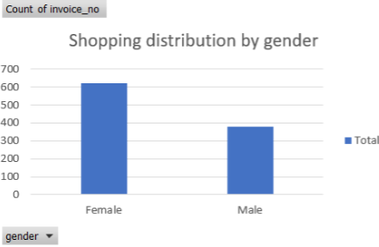
Shopping Distribution by Gender
Insights:
Female customers contribute the majority of purchases
Male customers have a lower shopping share.

Slide 7
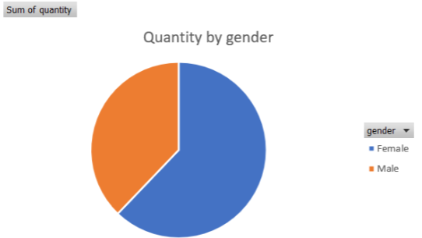
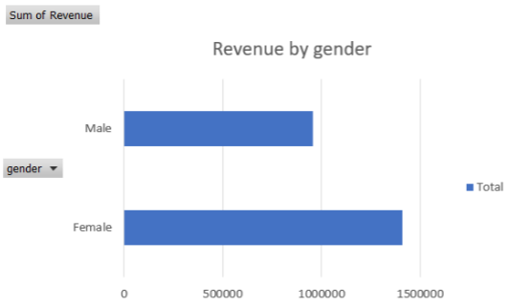
Revenue & Quantity by Gender
Insights:
Female customers purchase more products
Female customers generate higher revenue.

Slide 8
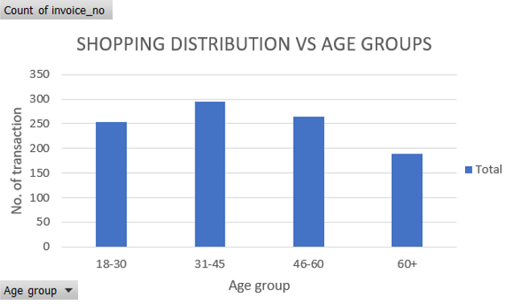
Shopping Distribution by Age Group
Insights:
35–55 age group has the highest shopping activity
18–35 is the second most active group
55–60 has the lowest contribution.

Slide 9
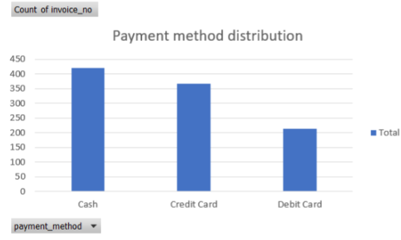
Payment Method Distribution
Insights:
Cash: 42%
Credit Card: 36%
Debit Card: 21%
Cash is the most preferred payment method.

Slide 10
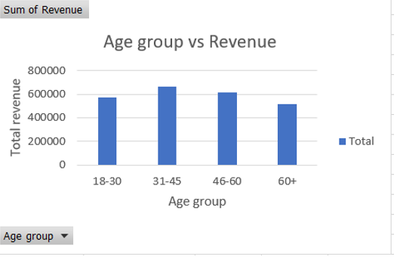
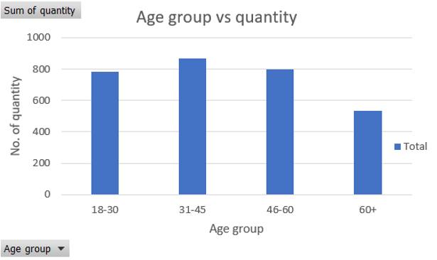
Revenue & Quantity by Age Group
Insights:
35–55 age group generates the highest revenue
18–35 contributes significantly
Older age groups show stable but lower spending.

Slide 11
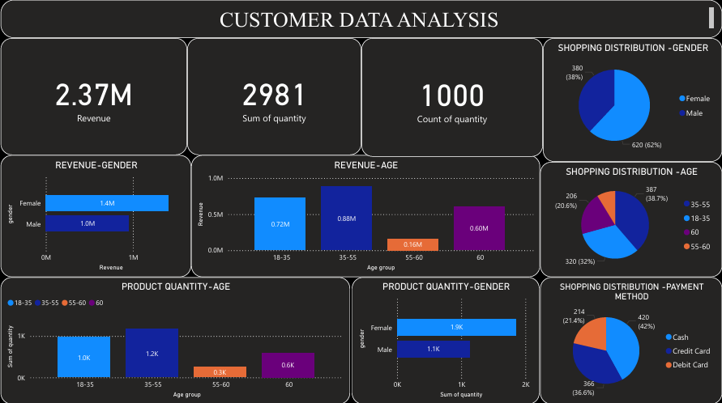

Slide 12
Category Performance Analysis
Insights:
Clothing shows high purchase volume
Technology generates high revenue per transaction
Female customers dominate Clothing & Cosmetics
Technology is preferred for high-value purchases.

Slide 13
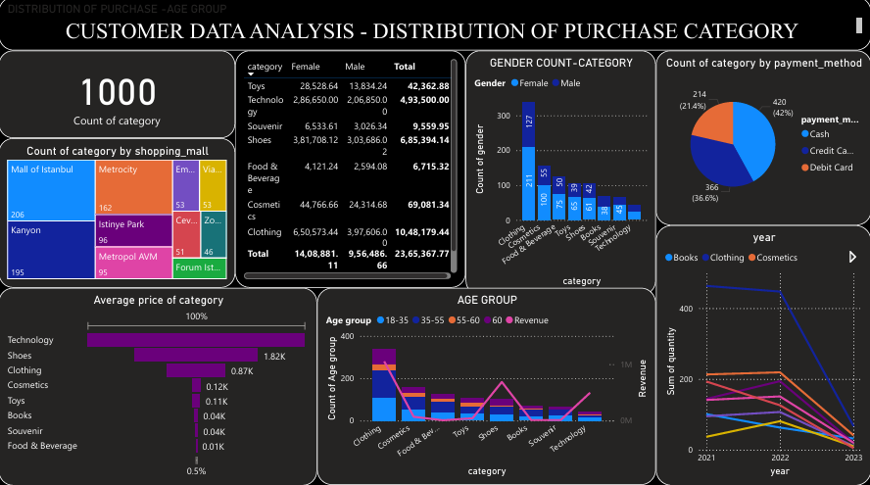

Slide 14
Payment Method Analysis
Insights:
Cash is the most used payment method
Credit cards are preferred for high-value purchases
Younger customers favor digital payments
Older customers rely more on cash.

Slide 15
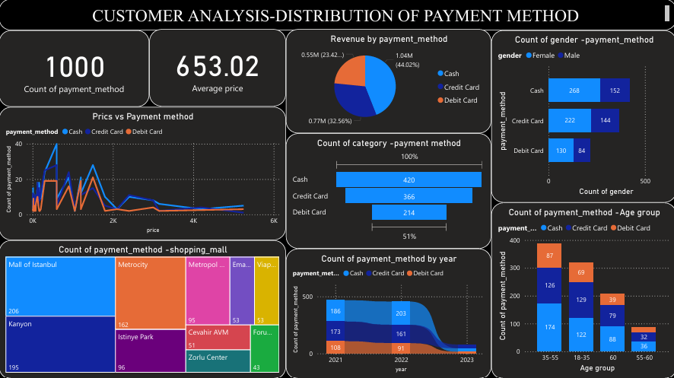

Slide 16
Tools Used & Conclusion
Tools Used:
Power BI – Data visualization & dashboard creation
DAX – Calculated measures and columns
Data Cleaning & Transformation techniques
Conclusion:
Female customers and the 35–55 age group are key revenue drivers
Clothing and Technology are the most impactful categories
Cash dominates payments, but digital adoption is increasing
These insights help improve customer targeting, sales strategy, and payment optimization.

Slide 17
Actionable Suggestions
Target Female customers with personalized offers
Focus marketing on 35–55 age group
Increase promotions on Clothing & Technology
Encourage digital payments with discounts
Introduce loyalty programs for repeat customers.

Slide 18
Thank you

